Slide 1
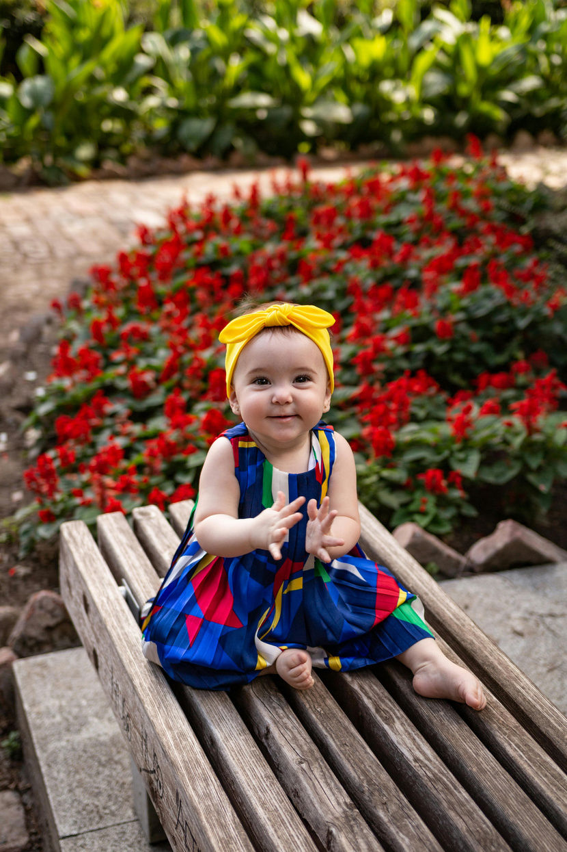


Baby room vision building online workshop
www.thebabyroom.blog
Dr Mona Sakr
Dr Sara Bonetti
Kayla Halls

Slide 2
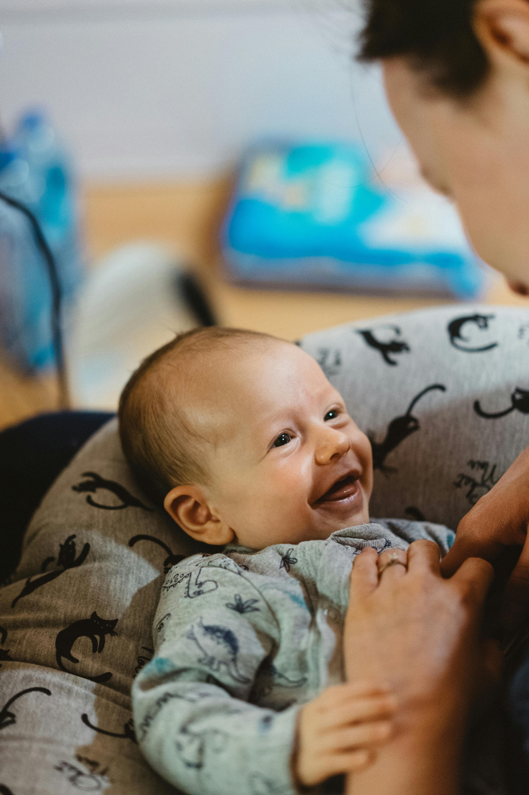

These slides will...
Support you to dialogue and create a vision of:
    An ideal baby room
    The baby room in the context of the nursery
    The baby room team
You can use these slides in a variety of ways, but we would recommend talking through one section per meeting (for a total of three vision-building sessions).

Slide 3


Vision building is our superpower!

Slide 4
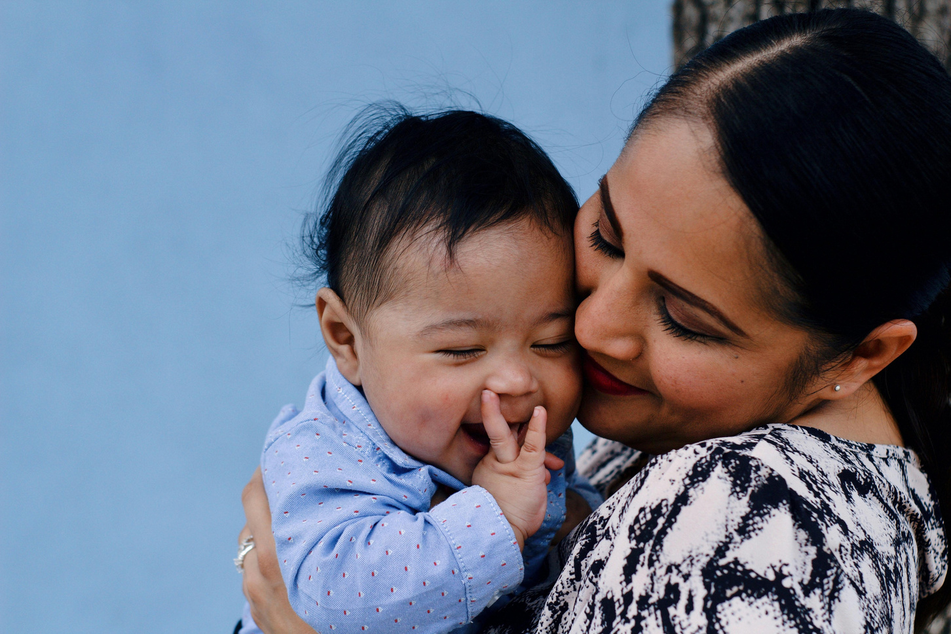
Imagine
an ideal
baby room…

Slide 5

How many babies are in the room?

Slide 6
Describe the atmosphere of the baby room in a few words.

Slide 7
In your ideal baby room, how are families involved?

Slide 8
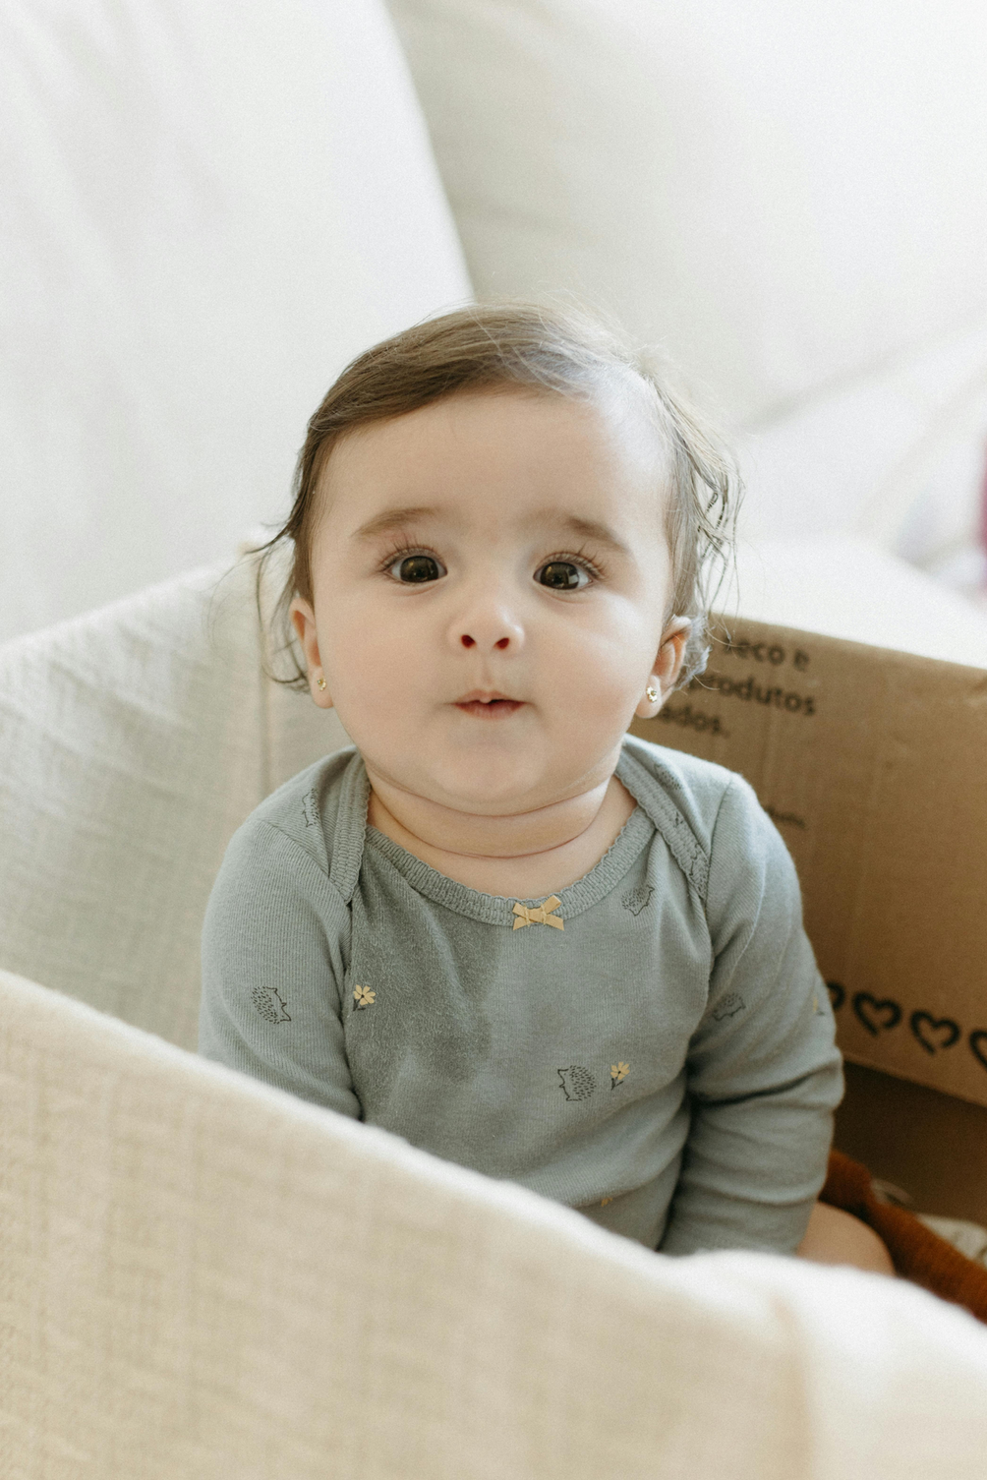
Imagine the baby room in the context of the nursery…

Slide 9
Where is your ideal baby room located in the nursery?

Slide 10
How important is it that babies regularly engage with the older children in the nursery? What does that look like?

Slide 11

How important is it that educators across the nursery regularly engage with the babies? What does that look like?

Slide 12
Imagine the
baby room team…

Slide 13
In your ideal baby room, what does every team member understand?

Slide 14
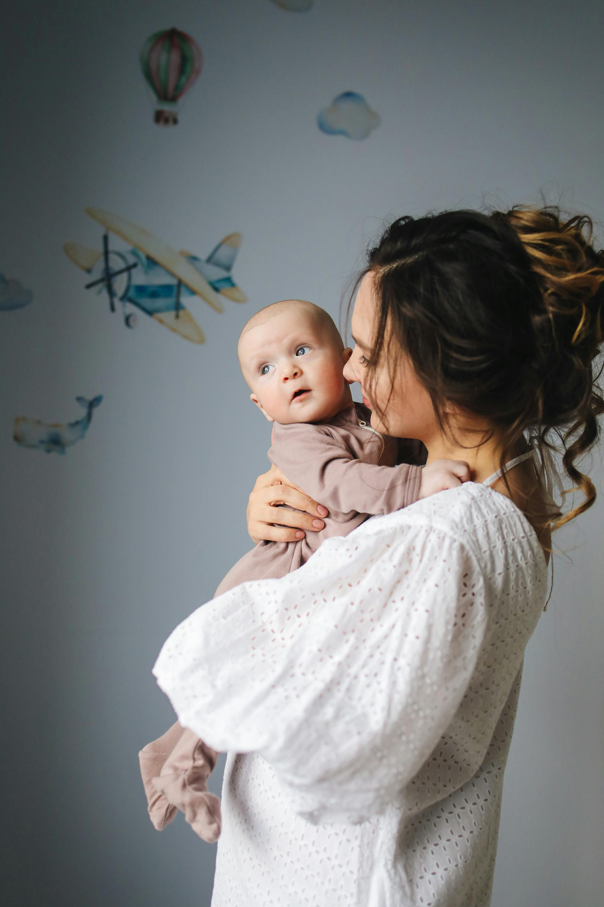
What support does your team have in an ideal baby room? Think through everything from coaching to team meetings to termly team building.

Slide 15
Describe the team culture in your ideal baby room in a few words.

Slide 16
On a really difficult day, how do we work together and interact with each other?

Slide 17


Free baby room vision-building resource!
We invite you to take vision building a step further with your baby room team.
Follow the link below for a visualization pack that includes exercises, reflection questions, and clear actions you can carry forward to support practice.
https://thebabyroom.blog/baby-room-vision-building-resource/

Slide 18

Thank you!
Head to our website to:
    Have a read of our latest report
    Check out free resources for nurseries
    Stay up-to-date on the project
    https://thebabyroom.blog/report-2/

